Slide 1

Insights into Australia’s Economy Dynamic Macro Group
Team: Maria Papangeli, Alexandra Chairopoulou
Professor: Petros Varthalitis

Slide 2
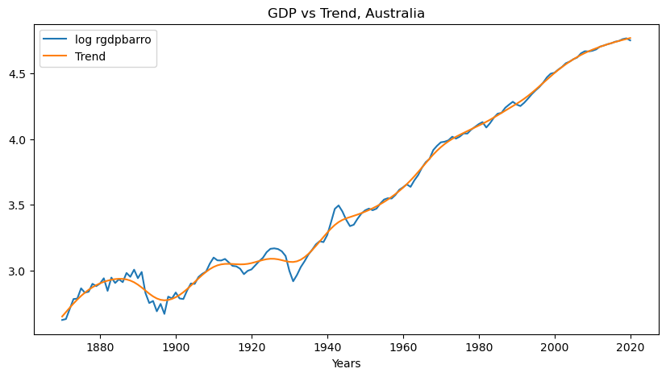
Business cycle analysis of Australia
This plot shows the logarithm of real GDP of Australia from 1870 to 2020, compared to its trend.
1900-1920: notable volatility(World War I,1915)
1920-1940: significant deviations (Great Depression,1930)
1940-1950: recovery in GDP (World War II)
After 2008: small dip (Global Financial Crisis). Australia's economy was resilient due to its strong mining sector.
2020: returns to its trend growth path.

Slide 3
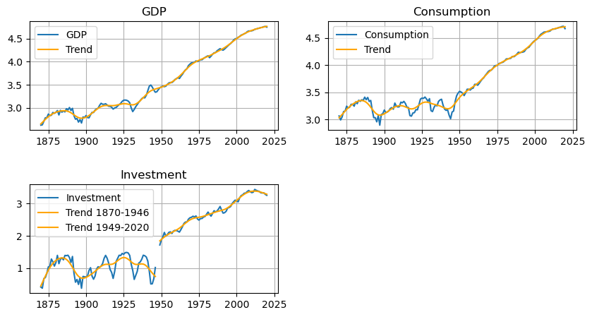
Business cycle analysis of Australia
These plots show the logarithm of three key macroeconomic indicators (GDP, Consumption, and Investment) compared to their trends over time, from 1870 to 2020. For the years 1947 and 1948 we have no data on investment. Therefore, we can not compute the trend for this years due to lack of data.
The logarithmic scale reveals the proportional growth rates and highlights periods of volatility in investment and consumption.

Slide 4
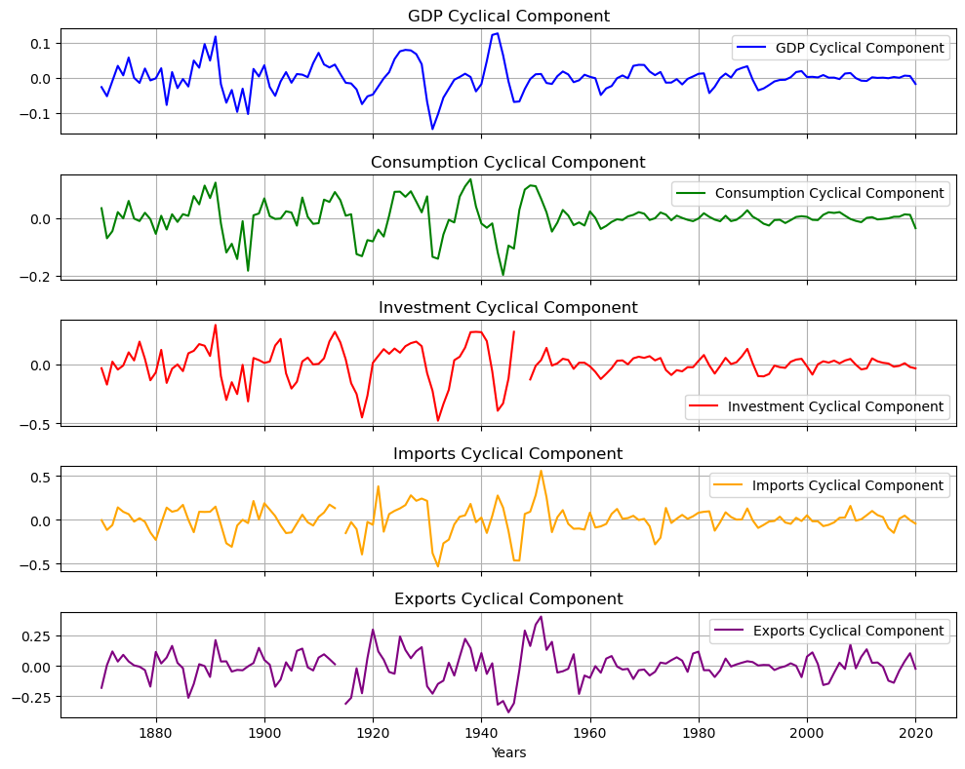
Business cycle analysis of Australia
These plots show the cyclical components of Australia’s economy (GDP, Consumption, Investment, Imports and Exports) over time.
GDP: Reflects cyclical nature, with notable volatility during events like the Banking Crisis (1890s), Great Depression (1930s) and World War II (1940). After the WW II Australia’s economy recovered quickly and boomed due to strong population growth, and increased demand for Australian exports.
Consumption: The Great Depression resulted in reduced household incomes, widespread unemployment, and lower consumption. The post-World War II boom reflects prosperity, driven by higher wages and government spending on infrastructure.
Investment: shows the highest volatility among the variables with sharp booms and dips(1930).
Imports and Exports: Both volatile and follow the same path. Imports are tied more to domestic demand, while exports are influenced by global demand. Imports: consumer goods, intermediate goods, capital equipment. Exports: iron ore, coal, LNG.

Slide 5
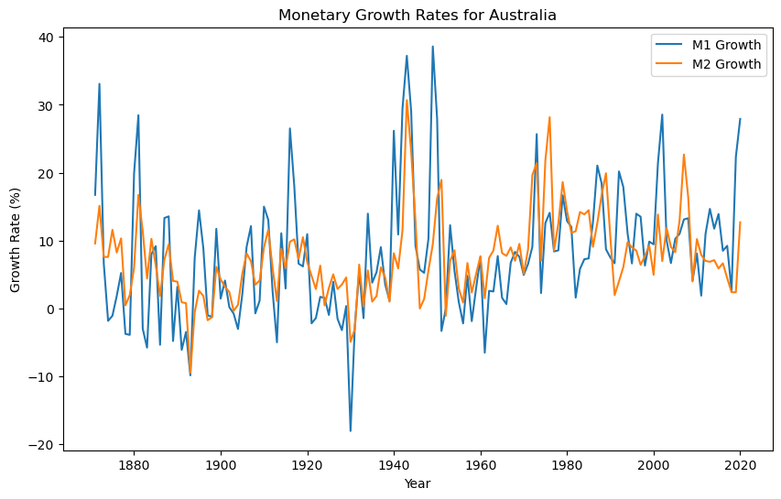
Monetary Cycles of Australia
This plot shows the growth rates (%) of monetary aggregates M1 and M2 for Australia over time. These are noticeable periods of volatility, especially around major historical events like the Great Depression (1930s) and World War II (1940s), where growth rates increased sharply or dipped significantly. This plot provides insight into the changes in money supply growth over time and how they responded to economic conditions.

Slide 6
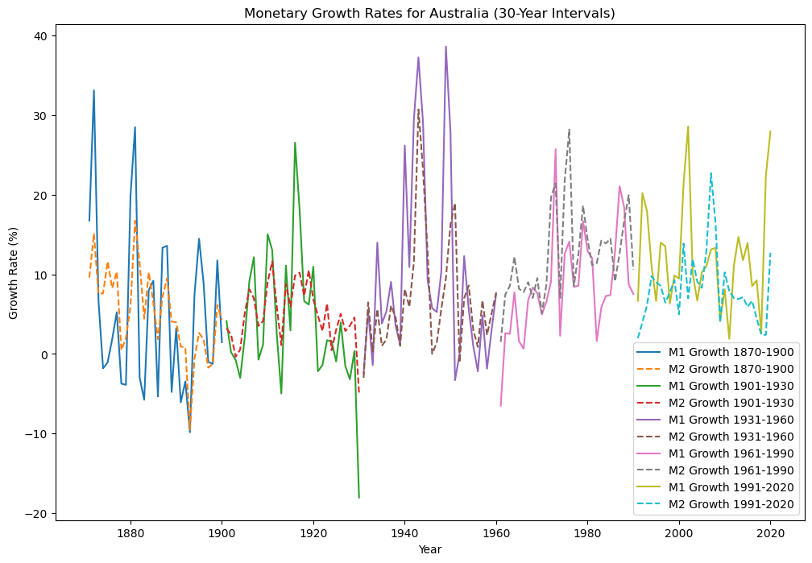
Subperiod analysis
1870–1900
This period was a time of both growth and instability for Australia's economy. The rapid growth was driven by the gold rush, agricultural expansion, and infrastructure development.
1901–1930
Between 1901 and 1930, Australia’s economy transitioned significantly, driven by federation, industrial growth, and eventually the challenges of the Great Depression.
1931–1960
From 1931 to 1960, Australia’s economy underwent significant transformation marked by recovery from the Great Depression, wartime economic mobilization, and post-war growth (World War II (1939-1945)).
1961–1990
From 1961 to 1990, Australia’s economy experienced significant changes, characterized by economic reform, globalization, and periodic challenges (economic, cultural and social).
1991–2020
This period was marked by robust economic growth, adaptability to global shifts, and resilience in the face of challenges(COVID-19 pandemic(2020)), setting the stage for future developments.

Slide 7
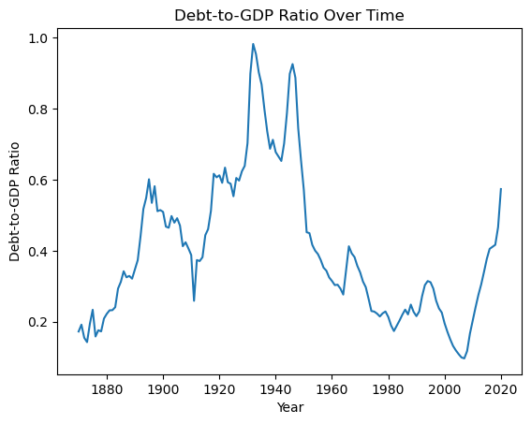
Fiscal sustainability analysis of Australia
This plot shows the debt-to-GDP ratio for Australia over time, from 1870 to 2020. The dept-to-GDP ratio represents the proportion of the country’s national debt compared to its GDP. The ratio shows significant peaks around the World Wars (1910s and 1940s), indicating high levels of debt relative to the economy during those periods. After World War II, the ratio declines steadily until around the 1970s, after which it remains relatively low but fluctuates. In the most recent period (post-2000), there is a noticeable increase in debt-to-GDP ratio, indicating rising public debt levels relative to GDP.

Slide 8
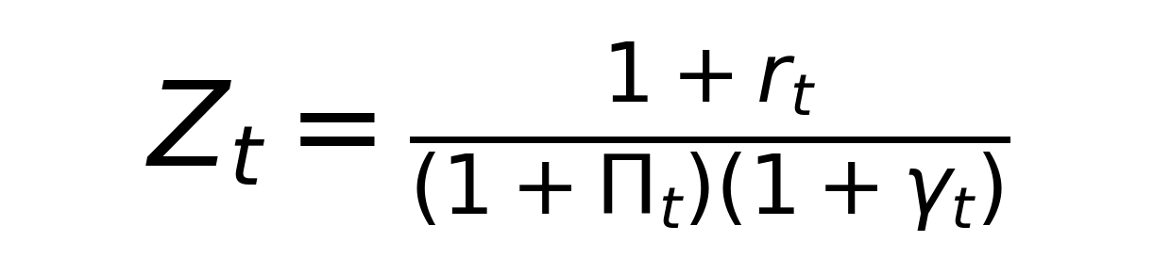
Interpretation of Z_{t}
Nominal Interest Rate (r_{t}):
Represents the cost of borrowing or the return on debt in nominal terms.
Inflation Rate (Π_{t}):
Measures the rate at which prices are increasing, impacting the real value of debt.
GDP Growth Rate (γ_{t}):
Reflects the rate at which the economy is expanding, influencing the capacity to sustain debt.
Role of Z_{t}:
Z_{t}>1: Indicates that debt grows faster than the economy's capacity to manage it, potentially leading to unsustainable public debt dynamics.
Z_{t}<1: Implies that economic growth and inflation outpace the growth of debt, stabilizing or reducing the debt-to-GDP ratio.
It serves as a critical measure in assessing fiscal sustainability by determining whether the growth in public debt aligns with the economy's ability to support it.

Slide 9

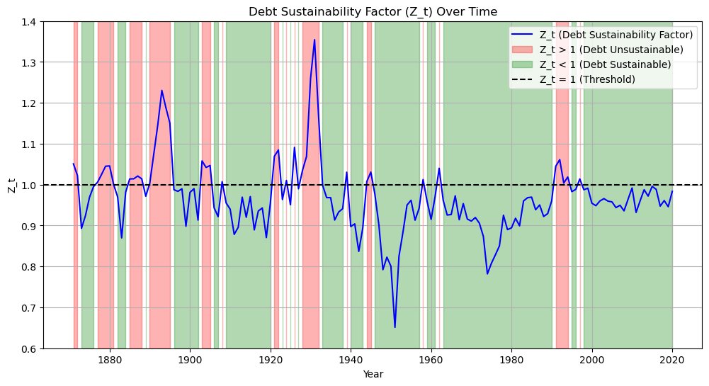


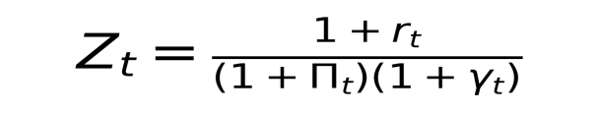
How public debt evolves with sub-periods of Z_{t}?
The above plot indicates how the public debt evolves over time. We computed the public debt using the formula . In the plot the red shaded areas indicate when Z_{t} > 1, suggesting times when debt growth outpaced the economic capacity to sustain it, making debt unsustainable (increasing public debt), while the green shaded areas indicate periods when Z_{t} < 1, showing times when economic growth and inflation outpaced debt growth, which helped to stabilize or reduce debt relative to GDP (decreasing public dept).

Slide 10

Thank you for your time and attention! Feel free to share any questions.
Maria Papangeli
Alexadra Chairopoulou

